Slide 1
INFO 656-01 Fall 2020 Project Planning
Week 6
Amir Imani

Slide 2
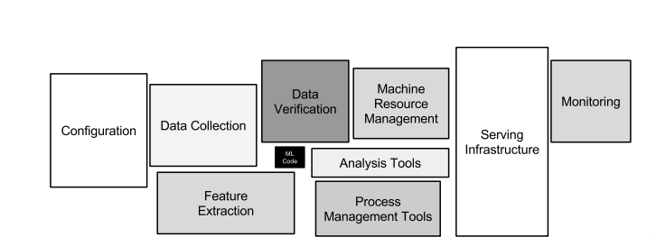
ML is Just a Tiny Fraction of the Project
https://papers.nips.cc/paper/5656-hidden-technical-debt-in-machine-learning-systems.pdf
Notes:
only a tiny fraction of the code in many ML systems is actually devoted to learning or prediction

Slide 3
Work Backwards!
Don’t expect Machine learning to figure out what problems to solve
Start with the ideal final state for your problem

Slide 4
Know your Audience
Ask the right questions
Clearly communicate results
Notes:
you need to definitely know who your audience is.
What is the exact goal of project?
Why am I spending time/resources on it?
How can you check whether the project delivered what you expected?
What is the expected timeline?
How much are you willing to spend (time/resource)?
Problems with communication Omitting/glossing over any key assumptions made during the analysis
Recycling the same presentation for different audiences
Saving all insights until a final presentation instead of making the process piecemeal and iterative

Slide 5
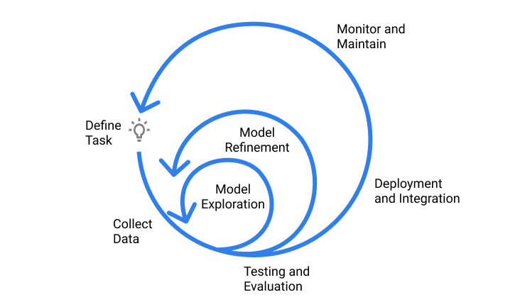
Iterate!
Start simple, then add complexity
Get feedback as frequently as you can
https://www.jeremyjordan.me/ml-projects-guide/
Notes:
Machine learning projects are highly iterative; as you progress through the ML lifecycle, you’ll find yourself iterating on a section until reaching a satisfactory level of performance, then proceeding forward to the next task
One of the things that makes ML systems so fascinating is that they often interact directly with the external world. Experience has shown that the external world is rarely stable. This background rate of change creates ongoing maintenance cost.

Slide 6
Project Proposal
No more than 1 page!
One paragraph, summary/purpose of the project (why, what, who)
One paragraph details of the problem (what)
One-two paragraph details of possible solution (how; including data sources, ML algorithms, expected output)

